Slide 1
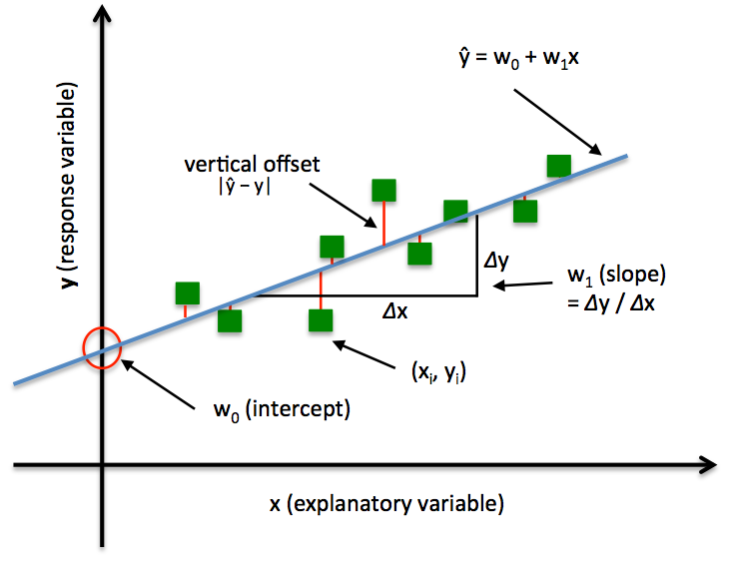

Simplest Possible Linear Regression Model
The regression model is
Where,
x is data variable
y is the value we are trying to predict
W₀ ₌ y- intercept
W₁ = the slope of the line and the
$Error ε=y_{i}−w_{0}−w_{1}x$
Notes:
1

Slide 2
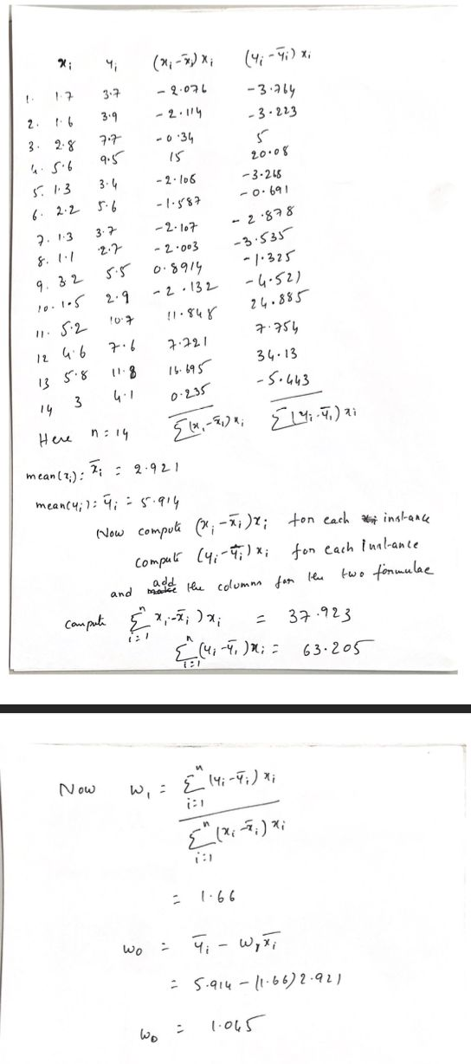





only works for univariate case, i.e. when you have only one variable. For multivariable regression use
$$\hat{w} = {\left(X^{T}X\right)}^{−1}X^{T}y$$
Notes:
2

Slide 3
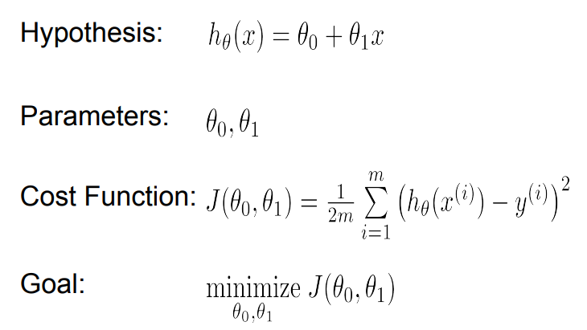
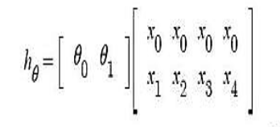
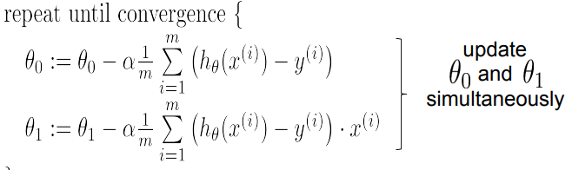



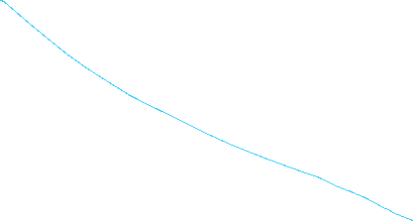
Gradient Descent for Univariate Linear Regression
$$h_{θ}\left(x\right)={θ_{0}x_{0}+θ}_{1}x_{1}= θ^{T}x$$
$x_{0}$ -> dummy feature with 1 for all samples
Cost function measures how close the predictions are to the actual y values
= learning gradiant

Slide 4
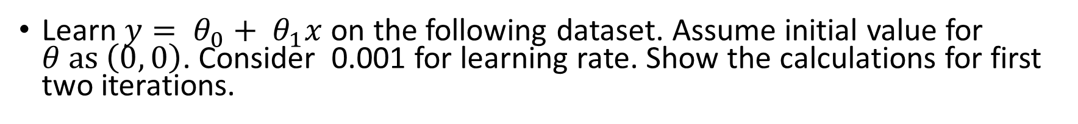
Exercise (1)
Learn $y= θ_{0}+ θ_{1}x$ on the following dataset. Assume initial value for $θ as \left(0, 0\right)$. Consider 0.001 for learning rate. Show the calculations for first two iterations.
Area (k feet^2) | Price (lakhs)
2 | 3
6 | 10
5 | 4
7 | 13

Slide 5
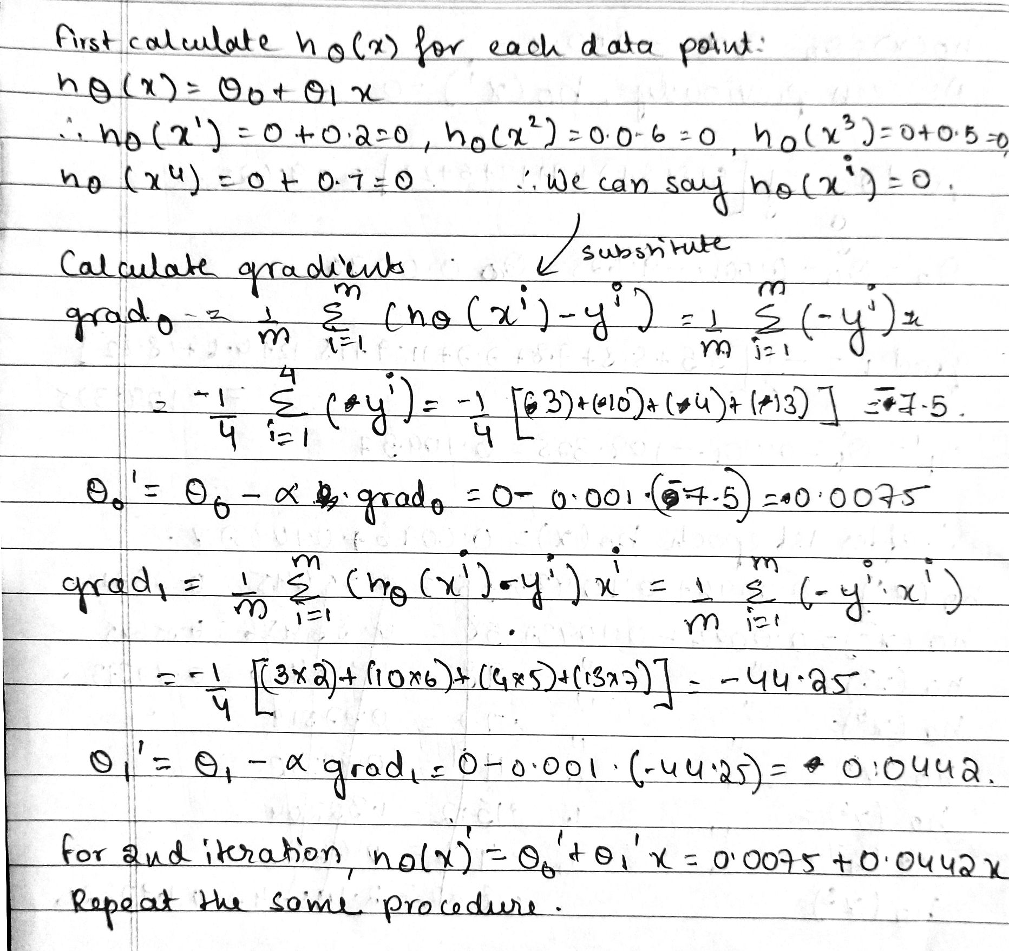

Slide 6

Exercise (2)
Suppose you are asked to build a machine learning model for predicting the output of machine based its operational time.
Write the hypothesis of your model
Train your model using the given dataset.
Using the model, predict the output if the machine runs for 13 hours.
You may assume learning rate of your model as 0.001 and the initial weights as 0.
$$y=h_{θ}\left(x\right)={θ_{0}+θ}_{1}x= θ^{T}x$$
Operating hours | 3 | 5 | 9 | 7 | 11 | 15 | 4 | 18
Output | 5 | 8 | 8 | 7 | 9 | 12 | 6 | 22
$$h_{θ}\left(x\right)=0.0096+0.10937x$$
After first epoch
$$h_{θ}\left(x\right)=0.0931+1.0167x$$
After second epoch

Slide 7
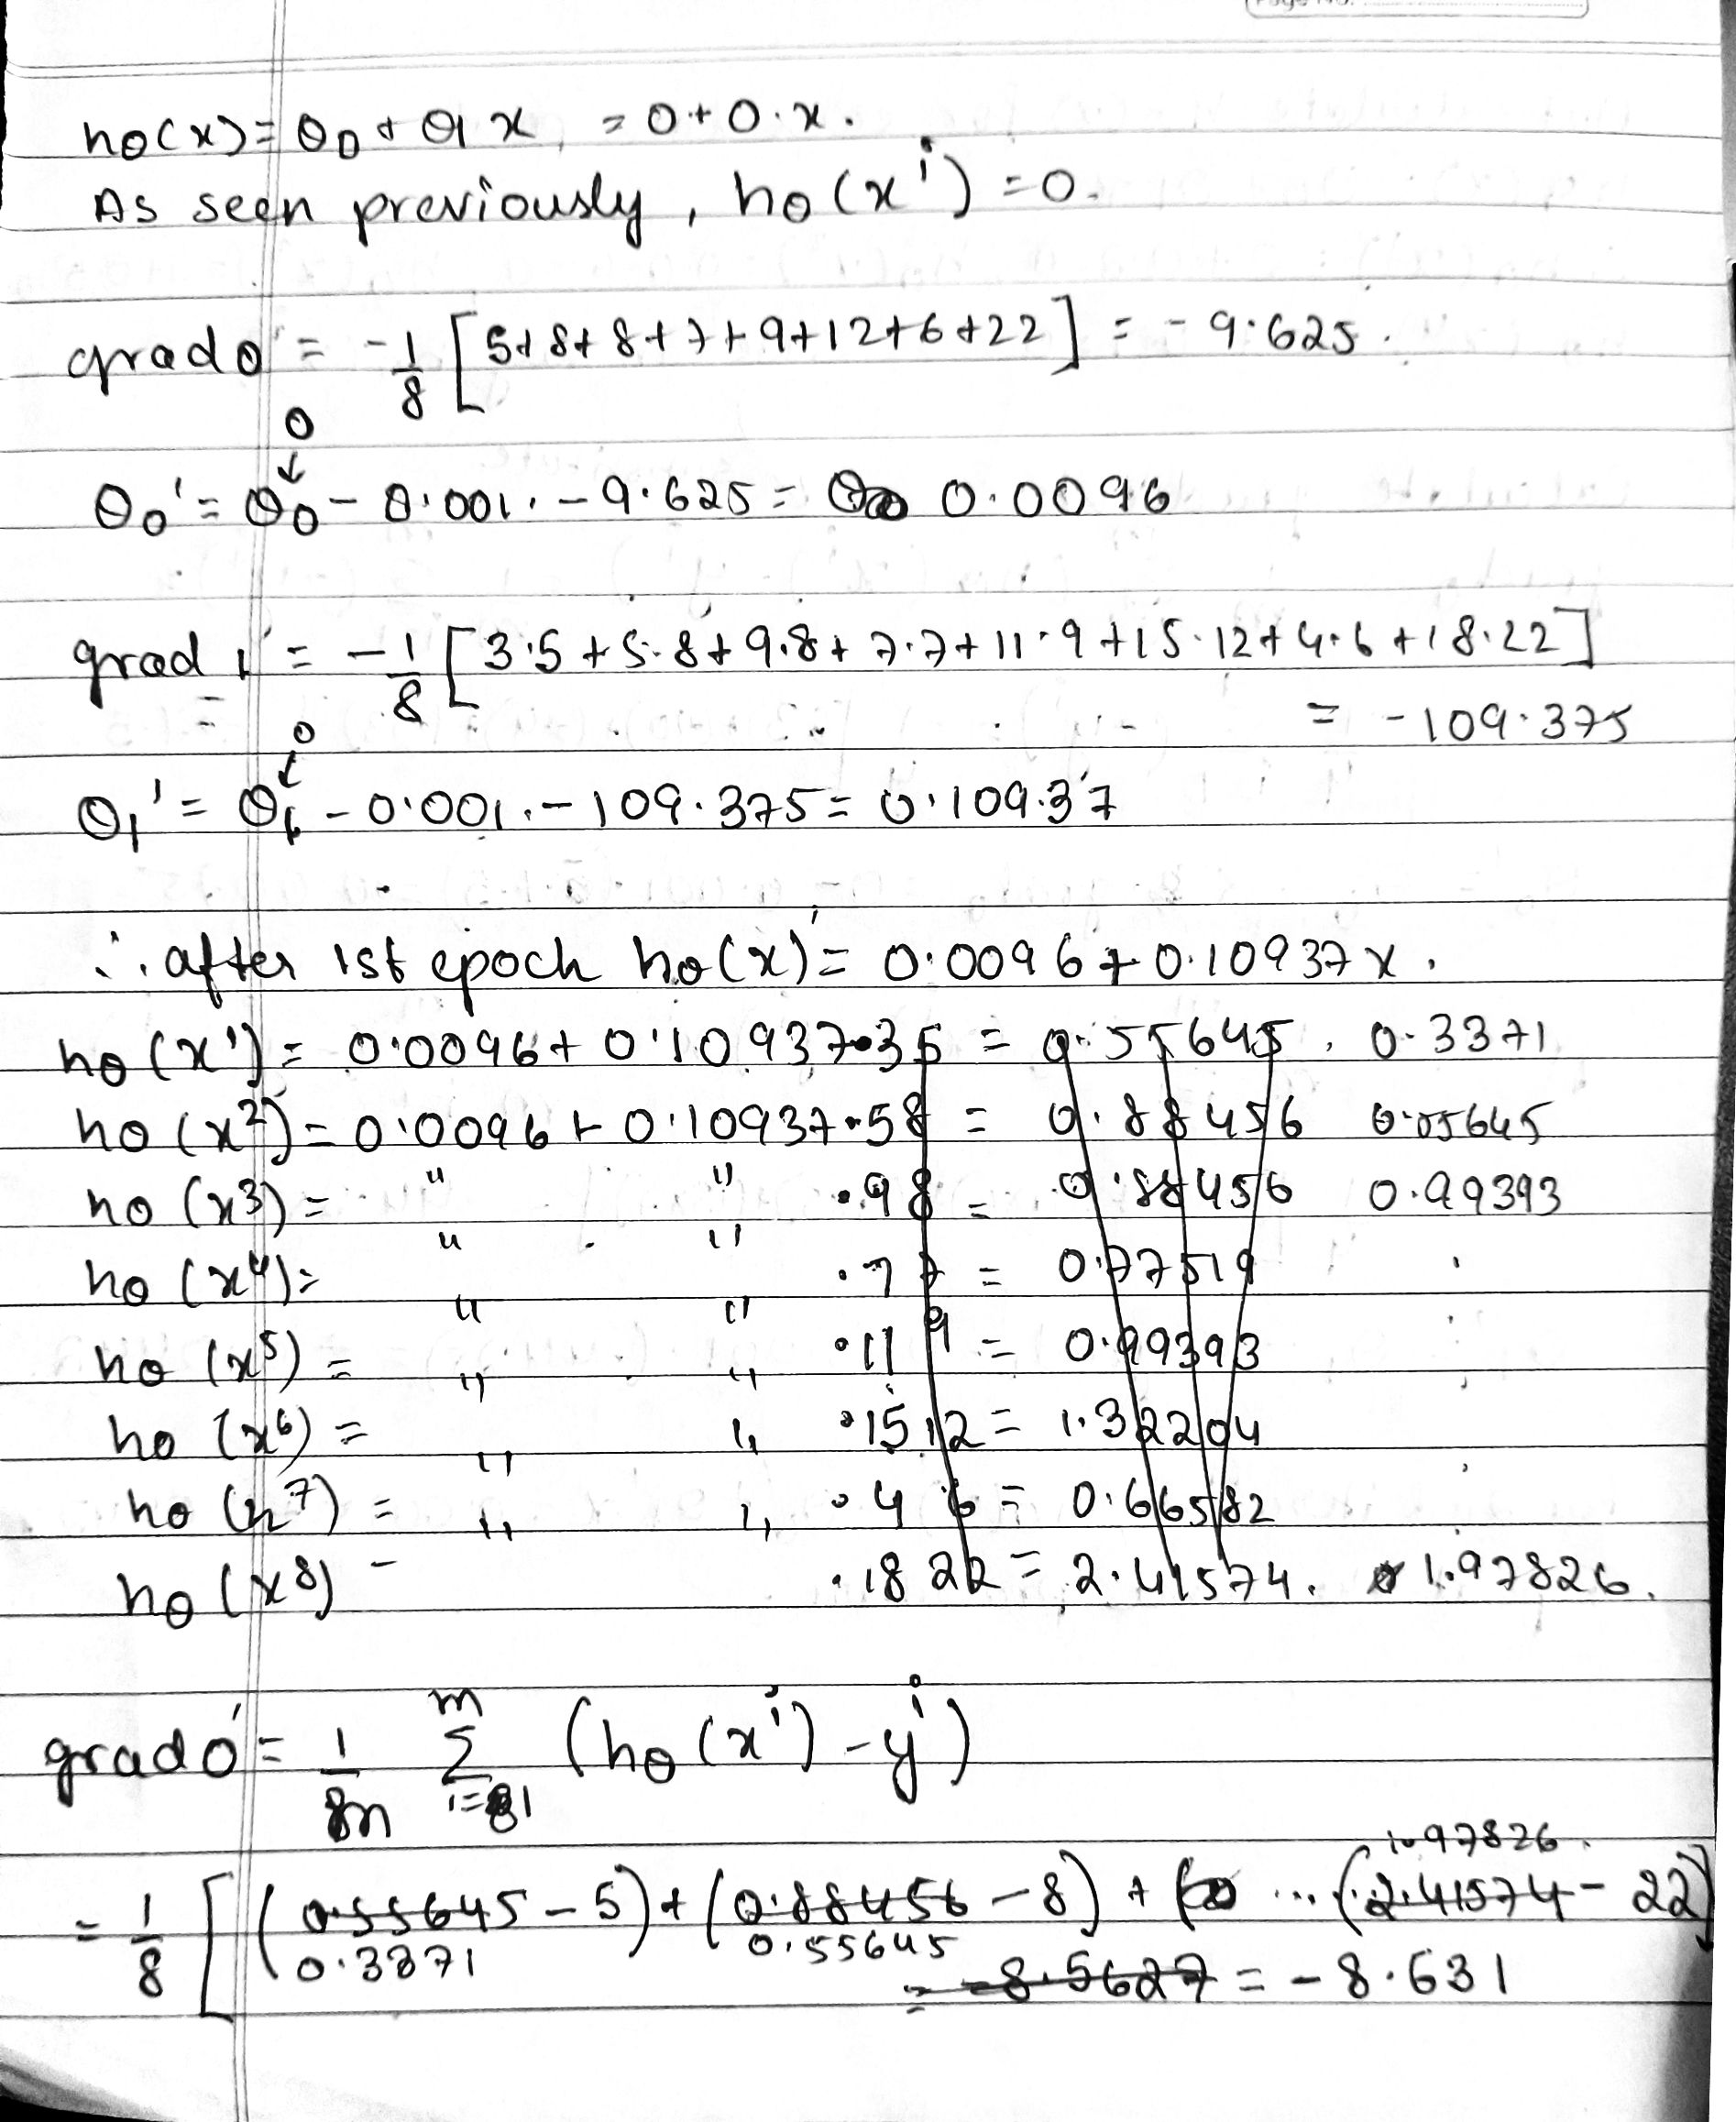

Slide 8
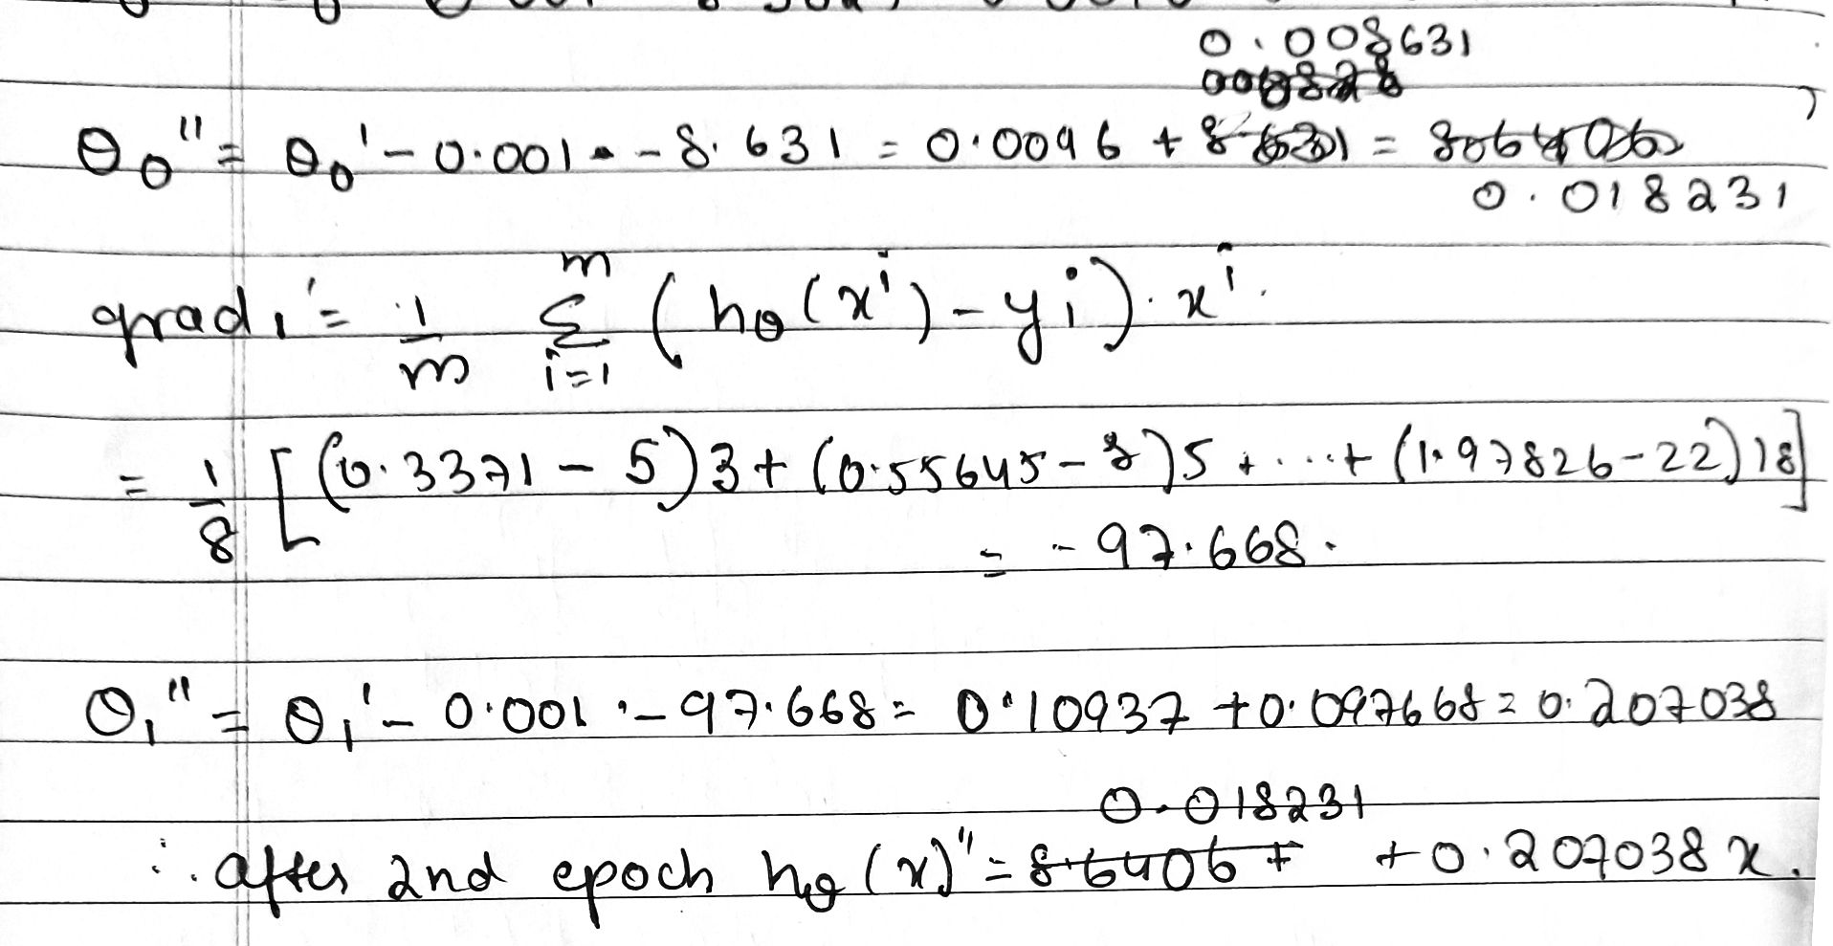

Slide 9
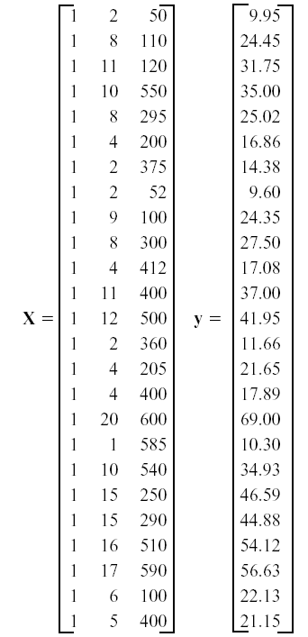
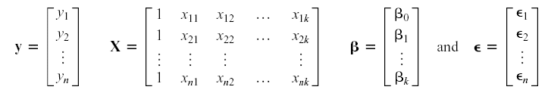

https://youtu.be/_OyKjstWe80?si=nZRmRzi_AJPdIbKI
Theory:
The resulting least squares estimate is

Slide 10
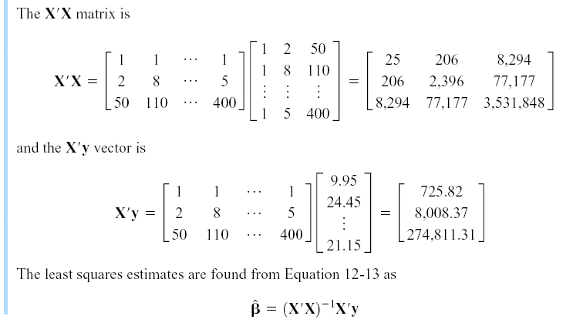




Solution:
Example 12-2

Slide 11
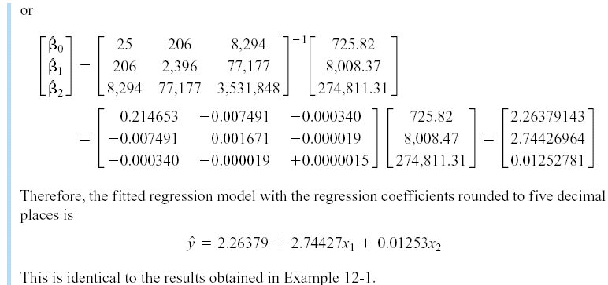

Solution
y = b0 + b1 x + b2 $x^{2}$

Slide 12
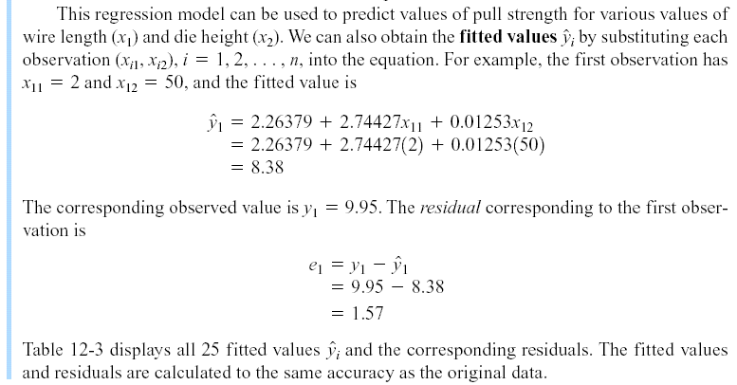
12-1 Multiple Linear Regression Models
Example 12-2

